Slide 1
Respiratory Conditions
Cough & Common Cold

Slide 2
Cough
Cough is a reflex action to remove secretions or foreign material from the airways. The majority of coughs presenting in the pharmacy will be caused by a viral upper respiratory tract infections (URTIs).

Slide 3
Types of cough according to nature:
Productive(wet or chesty); here ask about the color
Non-productive (dry or tight).

Slide 4
Types of cough according to duration:
Acute; which lasts < 3wks, mostly due to URT infection
Sub acute; between 3-8wks, which occurs after infection due to bronchial hyper-responsiveness
Chronic; which lasts > 8wks

Slide 5
Patient assessment of cough
1. Duration
2. Nature of Cough
3. Ass. Symptoms
4.Drug induced cough.
5.Conditions induced cough

Slide 6
WHEN TO REFER PATIENTS WITH COUGH?

Slide 8
Managements
Non-pharmacological treatment
Drink warm water > 2L/day
Steam inhalation
Lozenges ( compose of eucalyptus, mint, soothing agents)

Slide 9
2. Pharmacological treatments:
A- Expecturants: ex: guaifenesin guaicolate, ammonium salts. Used for productive (chesty) cough

Slide 10
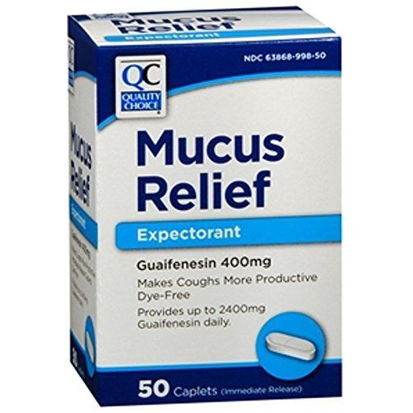

Slide 11
B- Anti-tussive, act directly on the cough center to depress the cough reflex. Their effectiveness has been investigated in patients with acute and chronic cough ex:
1* codiene
2* dextromethorphan
3* butamirate citrate

Slide 12
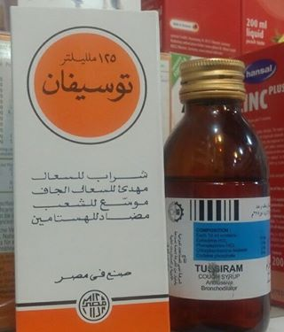
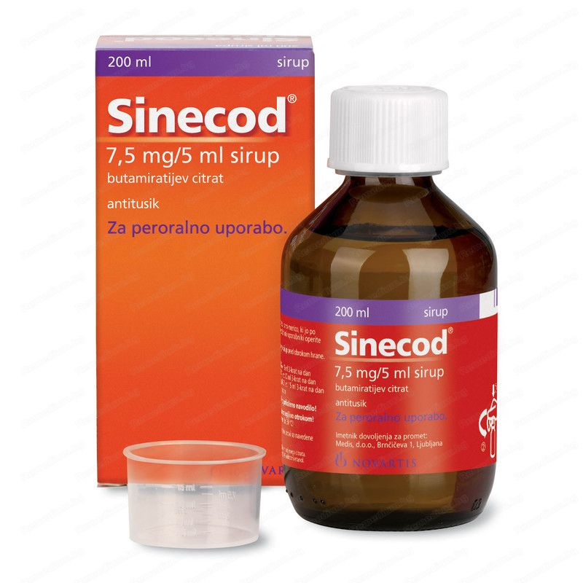

Slide 13
Additional preparations
Anti- Histamine have been included in cough remedies for decades. Their mechanism of action is thought to be through the anticholinergic-like drying action on the mucous membranes and not via histamine
Ex: diphenhydramine

Slide 14
Common Cold
Is a mixture of URT viral infection, self-limited but symptomatic treatment is required. Transmitted primarily by direct contact with the pt. or through air droplets. Caused by rhinovirus (common) or adenovirus.

Slide 15
Pt. assessment.:
1- Age
2- onset: common cold characterized by gradual onset
3- symptoms: mostly, common cold begins with sore throat followed by the other symptoms like sneezing, coughing, congestion, headache, …etc
4- medical hx: conditions similar to common cold in symptoms

Slide 17
Managements
A- non-pharmacological treatment; as mentioned in cough treatment
B- pharmacological
Due to the symptoms of common cold, the choose of medications will combination of
- anti-H1
- sympathomimetics
analgesic

Slide 18
Sympathomimetics agents: serve to constrict dilated blood vessels and swollen nasal mucosa, easing congestion and helping breathing. There are two dosage forms of sympathomimetics
Systemic: phenylphrine, pseudoephedrine
Topical: oxymetazoline, xylometazoline

Slide 19
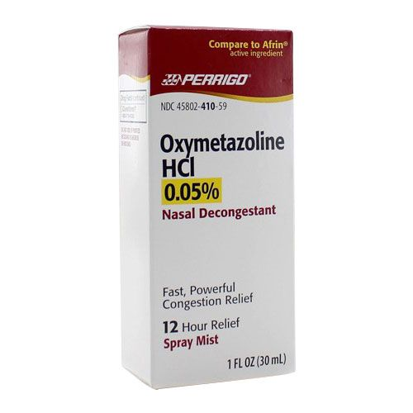

Slide 20
Properties of sympathomimetics
Topical drop suitable for DM, H.T patients
Must be awarded about D-D interaction
Duration of use, especially for topical
Time of administration, because insomnia may
happened
Age of patient and select the suitable agent

Slide 22
Rhinitis:
simply inflammation of the nasal lining. It is characterised by rhinorrhoea, nasal congestion, sneezing and itching. The majority of cases that present in a community pharmacy will be viral infection, colds or allergic rhinitis

Slide 23
Conditions to eliminate
Rhinitis medicamentosa
Rhinitis in pregnancy
Foreign body insertion in nose

Slide 24
Management
The key for controlling symptoms is by prevention. Especially for allergic rhinitis

Slide 25
Allergen avoidance
Anti-H1, either sedative or non-sedative
Sympathomimetics
Topical corticosteroid

Slide 26
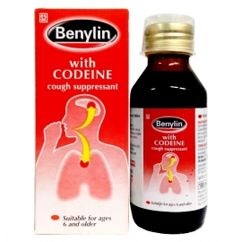
Treated with

Slide 28
for

Slide 29
55 yrs. old male with hypertension, recently has common cold. The best treatment is pseudoephedrine (with combination) product.

Slide 30
Drug-drug interaction between sympathomimetics and beta blocker, TCA, MAO-I

Slide 31
Female on ACE-I drug, suffered from dry cough. The best treatment is dextromethorphan tab 1*3

